Slide 1




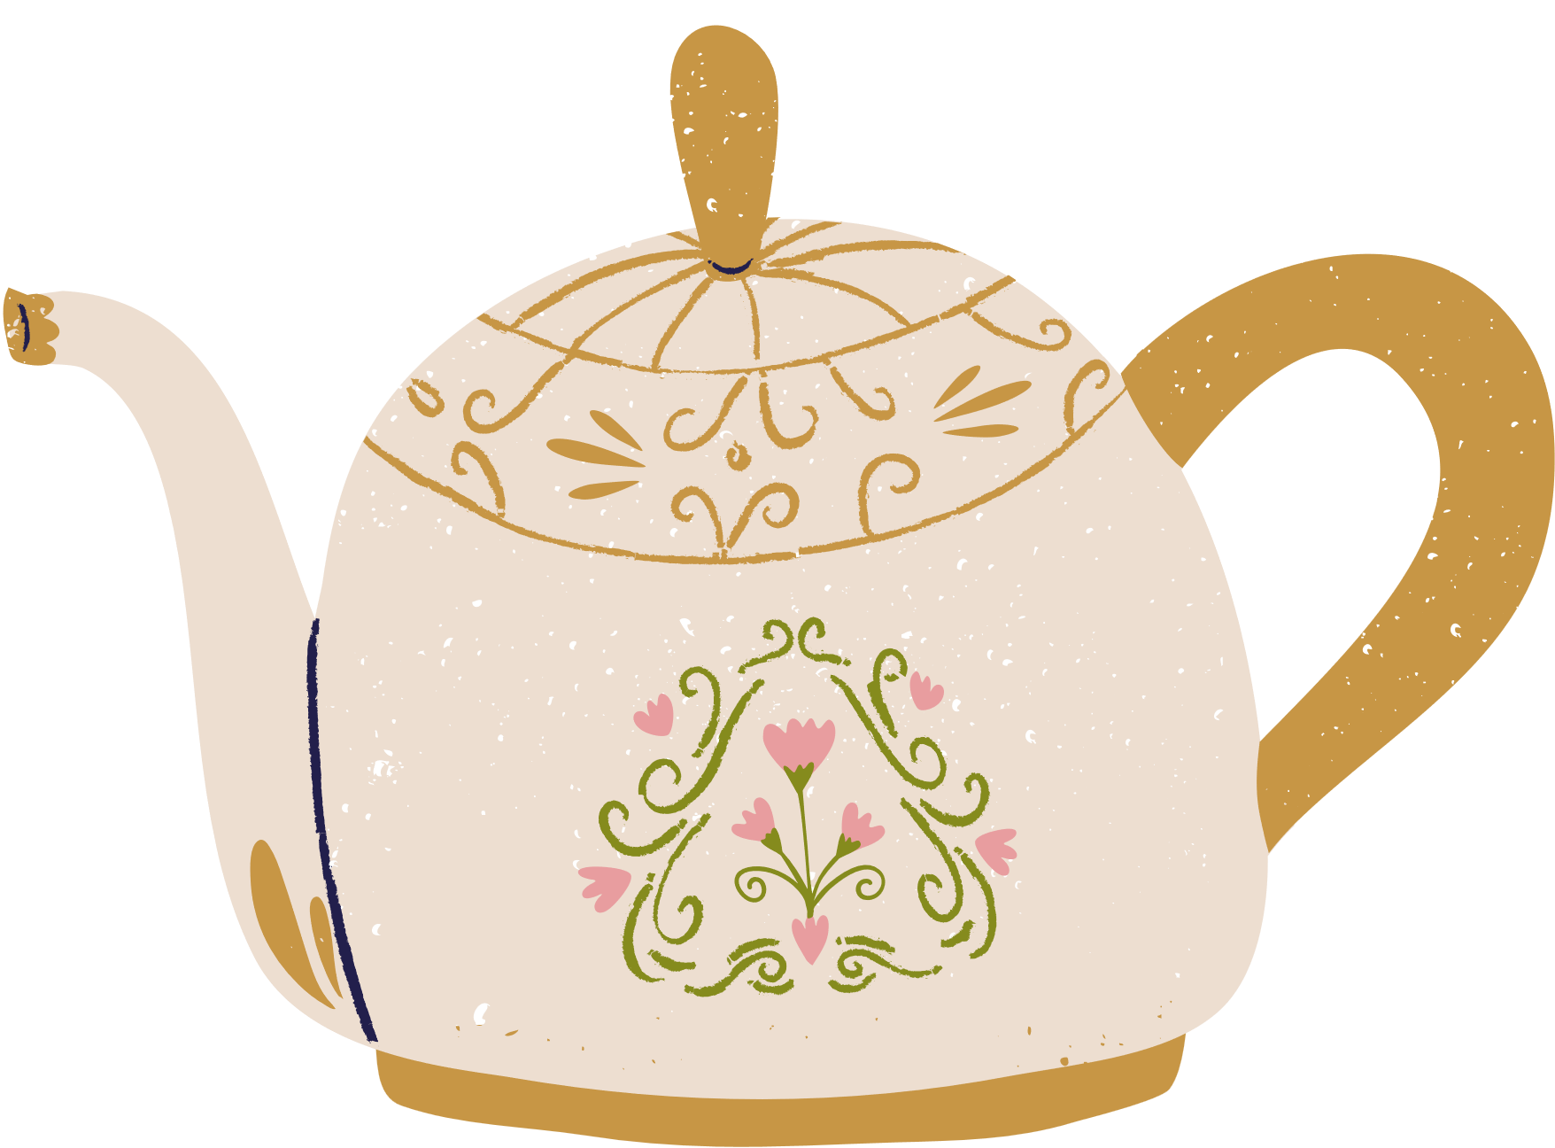
MINDNEST
GROUP 1

Slide 2
Project Description
University students face significant mental health challenges due to academic pressure, financial stress, social isolation, and adjustment difficulties.
Despite the availability of campus resources, many students:
Struggle to access help quickly during crises.
Lack immediate coping mechanisms for anxiety or panic attacks.
Neglect self-care due to overwhelming schedules.
Existing solutions such as counseling centers are often underutilized due to stigma, long wait times, or lack of awareness.

Slide 3
Mental Health Quiz
How often do you feel overwhelmed by stress or anxiety?
a) Rarely c) Often
b) Sometimes d) Almost daily
When stressed, do you know where to find immediate help?
a) Yes, I have contacts saved.
b) I know some resources but not how to reach them quickly.
c) No, I don’t know where to turn.
How often do you neglect self-care due to busy schedules?
a) Never
b) Occasionally
c) Frequently

Slide 4
Mental Health Quiz
What do you typically do to calm down during high-pressure situations
a)Scroll social media c) Meditate
b) Talk to someone d) Nothing
Would you use an app that combines emergency support, stress relief and self-care in one place?
a) Yes
b) Maybe
c) No

Slide 5

1
Solutions Provided
One-Tap Emergency Contacts
Reduced hesitation in seeking help by providing direct access to counselling and crisis lines
Help users regain emotional control during acute stress or panic through guided exercises and interactive task.
Combat wellness neglect by prompting hydration, breaks and mindfulness practices
2
Distraction Activities
3
Self-care Scheduler

Slide 6
Value Addition
To Students
To Universities
Immediate support, reducing reliance on overwhelmed campus services
Discreet Assistance which lowers stigma by providing private, anytime access
Proactive care which encourages healthy habits before crises escalate
Compliments existing servicess by directing students to appropriate resources
Provides ananymized analytics to improve mental health programs
Enhances student retention by addressing a key barrier to academic success

Slide 7


Database Structure
Database
@Database(
entities = [User::class, Distraction::class], // Current entities
version = 2,
exportSchema = false
)
abstract class AppDatabase : RoomDatabase() {
abstract fun userDao(): UserDao
abstract fun distractionDao(): DistractionDao
}

Slide 8
Database Structure
Model Classes
@Entity(tableName = "users")
data class User(
@PrimaryKey(autoGenerate = true)
val id: Int = 0,
val username: String,
val email: String,
val password: String, // Note: Should be hashed in production
val birthday: String
)
@Entity(tableName = "distractions")
data class Distraction(
@PrimaryKey(autoGenerate = true)
val id: Int = 0,
val title: String,
val description: String,
val category: String, // e.g., "quick", "guided", "physical"
val durationMinutes: Int = 5
)

Slide 9
Core Functionality
Self-care System
Customizable reminder scheduling
Alarm-based notifications
User Management
Login/ Registration flow
Session persistence
Emergency Resources
One-tap helpline
Pre-loaded contacts
Expandable list
Distraction Tools
Interactive breathing exercise with visual guidance
5-4-3-2-1 grounding technique walkthrough
Fun activities

Slide 10
Non Functional Req.
Category
Status
Performance
Fast navigation between screens
Reliability
Emergency calling works 100%
Usability
Intuitive Material 3 UI with clear navigation
Compatibity
Works on Android 12 +

Slide 11



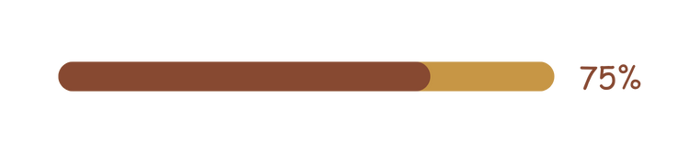
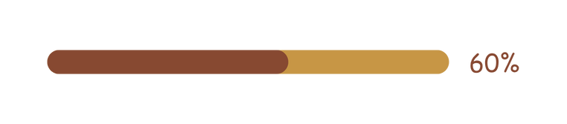
Functional Completion
Emergency
Distraction
Self-care
Navigation
UI/UX

Slide 12


Colour Scheming
Header
Buttons
Navigation Bar
Accents
Text
Borders
Notification
Alerts

Slide 13


Let’s Work Together
Quinter Jaika
Esborn Kihiu
Alex Muiruri

